Slide 1
Spreadsheet Project: IT Ticket Analysis
Ujwal Kumar
02/07/2026

Slide 2

Agenda
Problem Statement
Data Description
Objective Key Metrics and Visualizations
Subjective Question for Insights

Slide 3
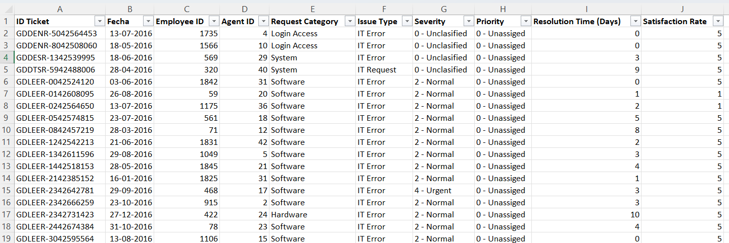
Problem Statement
The objective is to analyze the IT support ticket management system to understand the performance of IT agents, the efficiency of ticket resolution, and the satisfaction levels of employees. The analysis aims to identify high and low performers among IT agents, assess the overall effectiveness of the team, and pinpoint areas for improvement in the ticket resolution process. The ultimate goal is to make informed staffing decisions, including hiring, firing, and training, to enhance overall service quality and team performance.

Slide 4
1. Evaluate IT Agent Performance Measure productivity by analyzing tickets handled per agent. Identify high performers and low performers. 2. Assess Ticket Resolution Efficiency Track average and daily resolution times. Compare resolution times across agents and ticket categories. 3. Analyze Employee Satisfaction Monitor satisfaction levels linked to ticket resolution. Correlate satisfaction with resolution speed and issue severity.
Objectives

Slide 5
4. Identify Training Needs Detect agents with recurring performance gaps. Flag agents who require additional support or mentoring. 5. Support Staffing Decisions Provide data-driven insights for hiring additional agents. Recommend firing or retraining underperforming agents. 6. Understand Ticket Trends & Workload Analyze ticket volumes over time to detect peak and stable periods. Study distribution of issue types and categories (Login, System, Software, etc.).

Slide 6
Attributes:
Resolution Time (Days): Time taken to resolve the ticket.
Satisfaction Rate: Satisfaction rate provided by the employee (1-5 scale).
IT Agents: Contains information about IT agents.
Agent ID: Unique identifier for the agent.
Full Name: Full name of the agent.
Email: Email address of the agent.
Year of Birth: Year the agent was born.
Month of Birth: Month the agent was born.
Day of Birth: Day the agent was born.
Tickets Sheet: Contains information about IT support tickets.
ID: Unique identifier for the ticket.
Ticket Fecha: Date of the ticket.
Employee ID: ID of the employee who raised the ticket.
Agent ID: ID of the agent assigned to the ticket.
Request Category: Category of the request (e.g., Login Access, System, Software).
Issue Type: Type of issue (e.g., IT Error, IT Request).
Severity: Severity of the issue.
Priority: Priority level of the issue.

Slide 7
Methodology
Data Collection & Preparation
Collect datasets (Tickets, Agents, Employee Satisfaction).
Clean the data by handling missing values, duplicate entries, and inconsistent formats.
Standardize categorical fields (e.g., severity levels, issue categories).
Extract additional attributes where needed (e.g., domain from email, full agent name from ID).
Descriptive Analysis
Count total attributes, categorical vs. continuous variables.
Identify missing/inconsistent values and calculate their counts.
Use Pivot Tables to compute:
Ticket volumes (daily, monthly, quarterly).
Average resolution times.
Ticket distribution by category, issue type, and severity.

Slide 8
Agent Performance Analysis
Measure key performance metrics:
Number of tickets handled per agent.
Average resolution time per agent.
Satisfaction scores per agent.
Use pivot tables with conditional formatting to flag high vs. low performers.
Apply formulas/aggregations to identify agents needing additional training.
Trend Analysis
Track ticket volumes over time (line charts for daily/monthly/quarterly).
Track satisfaction levels over time.
Identify peak periods vs. stable times.
Compare ticket trends with resolution times for workload impact.
Correlation & Relationship Analysis
Analyze correlation between severity of issues and resolution time.

Slide 9
Segmentation Analysis
Segment tickets by request category, priority, and severity.
Compare performance across different ticket categories.
Segment agents based on workload and outcomes.
Dashboard Development
Build an Excel Dashboard to summarize findings:
Ticket volume trends (line/area charts).
Ticket distribution by category (pie/donut chart).
Average resolution times (bar chart).
Agent performance (leaderboard table + conditional formatting).
Satisfaction trends (line chart).
Use slicers (filters) for dynamic segmentation (e.g., filter by severity, category, agent).
Decision Support & Recommendations
Identify agents needing training, hiring, or potential replacement.

Slide 10
VISUALIZATIONS
Ticket Category Distribution across different Request Categories
Highest: System(40%)
Lowest: Hardware(10%)
Login Access(30%)
Software(20%)

Slide 11
Yearly Ticket Distribution
Stable Early Years (2016–2017): Ticket volumes remained relatively steady with only minor fluctuations.
Significant Growth Post-2018: A noticeable rise in ticket volume began from 2018, indicating increasing IT support demand.
Overall Upward Trend: The consistent growth over the years highlights expanding IT activity and workload, emphasizing the need for scalable solutions.

Slide 12
Tickets By Severity
Majority Normal Severity: Most IT tickets fall under the Normal category, representing routine and manageable issues.
Few Critical Cases: Only a small portion of tickets are classified as Major, Minor, or Urgent, with almost none Unclassified.
Stable IT Environment: The low volume of severe cases indicates a well-controlled system with minimal high-impact disruptions.

Slide 13
Distribution of Tickets Based On Resolution Time
Fast Resolutions: Most IT tickets are resolved within 1–3 days, showing quick response and effective issue handling.
Few Long Delays: Ticket count decreases as resolution time increases, with very few taking over 10 days to close.
Efficient Support Performance: The trend highlights an efficient IT team that promptly resolves most issues, with only complex cases taking longer.

Slide 14
Distribution Of Tickets Based On Satisfaction Rate
Most users rated their experience 4 or 5, showing strong approval of IT support services.
Very few tickets received low scores (1 or 2), indicating minimal dissatisfaction.
Overall feedback reflects a high-performing IT team delivering reliable and effective support.

Slide 15
Training Requirement For Agents
Agents with resolution time more than the average resolution time and satisfaction rate less than the average needs additional training. Agents with IDs 3, 9, 11, 41, 22, 28, 33, and 19 fall in this range. The chart shows trends in resolution time, satisfaction rate, and ticket volume over the years. While the number of tickets has steadily increased, the average resolution time has not improved significantly, remaining around 4–5 days. The satisfaction rate has also stayed nearly constant, suggesting that higher workloads may be affecting service quality.
This indicates a need for agent training to improve efficiency in resolving tickets faster and enhancing user satisfaction. Focused training on technical skills, prioritization, and time management can help agents handle the growing ticket volume more effectively and boost overall service performance.

Slide 16
From 2016–2020, both resolution time and satisfaction rate remained stable, showing dependable IT support operations. Average resolution time stayed between 4.4–4.8 days, indicating consistency but limited improvement in speed. Satisfaction rates gradually improved to 4.1–4.2 by 2019–2020, reflecting steady enhancement in user experience.
IT Support Team Performance Over Years

Slide 17
Satisfaction Rate By Age Group
The chart shows average satisfaction rates across different age groups, ranging roughly between 2.7 and 5.
Most age groups report high satisfaction (around 4–5), with only a few groups showing lower values, such as 35–37 and 41–43.
Overall, satisfaction remains fairly consistent, with only minor fluctuations across age ranges.

Slide 18
1. Ticket Management: Total Tickets Logged (count of Ticket_ID) Average Daily Ticket Volume (tickets/day) Ticket Volume Trend Over Time (line chart, monthly/quarterly) Ticket Category Distribution (bar/pie: Login, System, Software, etc.) Issue Type Distribution (IT Error, IT Request, etc.) Severity & Priority Mix (stacked bar chart) Helps identify workload patterns & peak demand periods. Average Resolution Time per Agent (compare against team average) Satisfaction Rate per Agent (heatmap or bar chart) Training Needs Flag (Yes/No → agents below satisfaction and above resolution average) Helps assess productivity & identify training or resource gaps. 2. Agent Performance (Workforce View) Tickets Handled per Agent (bar chart)
Metrics to be Considered For Final Dashboard

Slide 19
3. Service Quality (Customer View) Average Resolution Time (overall trend) Average Satisfaction Rate (trend + distribution) Correlation: Severity vs. Resolution Time (scatter chart) Satisfaction Trend Over Time (line chart with threshold, e.g., <80% flagged) Helps monitor how well IT is serving employees. 4. Strategic / Investment Decision Metrics Peak vs. Stable Periods (ticket volumes + satisfaction trends) Cost-Benefit Indicators: If hiring more agents → compare resolution time vs. volume spikes If training → compare flagged agents vs. improvement opportunities If upgrading tools → compare pre/post implementation trends (if data available)

Slide 20
INSIGHTS
Ticket Volume & Trends
Average daily ticket volume → baseline workload.
Ticket volume trend over time (daily, monthly, quarterly) → peak workload periods vs. stable times.
Ticket Characteristics
Distribution by category/issue type (Login, System, Software, etc.) → most common problem areas.
Severity vs. Resolution Time correlation → higher severity tickets usually take longer, validating prioritization logic.
Priority analysis → whether high-priority tickets are actually resolved faster.
Agent Performance
Tickets handled per agent → workload distribution (are some overloaded?).
Average resolution time per agent → efficiency comparison.
Satisfaction scores per agent → effectiveness & soft-skill evaluation.
Identify top performers (fast + high satisfaction) and low performers (slow + low satisfaction).
Agents with poor metrics across multiple tickets → candidates for training or performance review.

Slide 21
Satisfaction & Service Quality
Trends in satisfaction over time → whether service is improving or declining.
Satisfaction by request category → some categories may frustrate employees more.
Agent-wise satisfaction → highlights need for training in communication/technical skills.
Segmentation Insights
By request category → some categories may require dedicated specialists.
By severity/priority → workload vs. SLA compliance.
Segmentation helps decide where to invest (e.g., if "Software" tickets take longest → invest in automation/training there).
Decision-Making Insights
Hiring: If peak loads cannot be met with current staff.
Training: If specific agents/categories consistently show poor satisfaction or long resolution times.
Firing: Only if consistent underperformance remains after training.

Slide 22
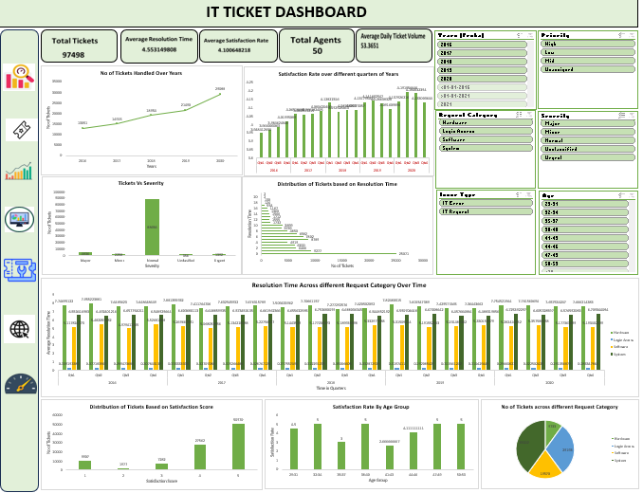
DASHBOARD

Slide 23
Conclusion
The analysis of the IT support ticket management system reveals key strengths and areas for improvement in agent performance, ticket resolution efficiency, and employee satisfaction. While high-performing agents demonstrate quick resolution times and consistently strong satisfaction ratings, certain agents require additional training to improve both technical and soft skills. The data also highlights workload imbalances, peak ticket periods, and process inefficiencies that could be addressed through better staffing strategies and potential investments in technology upgrades. Overall, a combination of targeted training, optimized staffing during high-demand periods, and selective adoption of improved ticket management tools will enhance service quality, employee satisfaction, and the overall performance of the IT support team, enabling more informed and effective decision-making for the future.

Slide 24


